Slide 1


Slide 2
INTRODUCTION
Heart Disease remains one of the leading cause of mortality worldwide, making early detection critical for saving lives. In this project, we combine SQL-based data exploration and SparkML-based predictive modeling to analyze patient data from the UCI Heart Disease dataset. Our goal is to uncover key risk patterns, identify high-risk patient profiles, and build robust machine learning models that can accurately predict the presence and severity of heart disease.

Slide 3
DATASET OVERVIEW
Heart Disease dataset from UC Irvine Machine Learning Repository
Source: UCI Machine Learning Repository – Heart Disease Dataset
Dataset was downloaded from Kaggle
https://www.kaggle.com/datasets/redwankarimsony/heart-disease-data

Slide 4
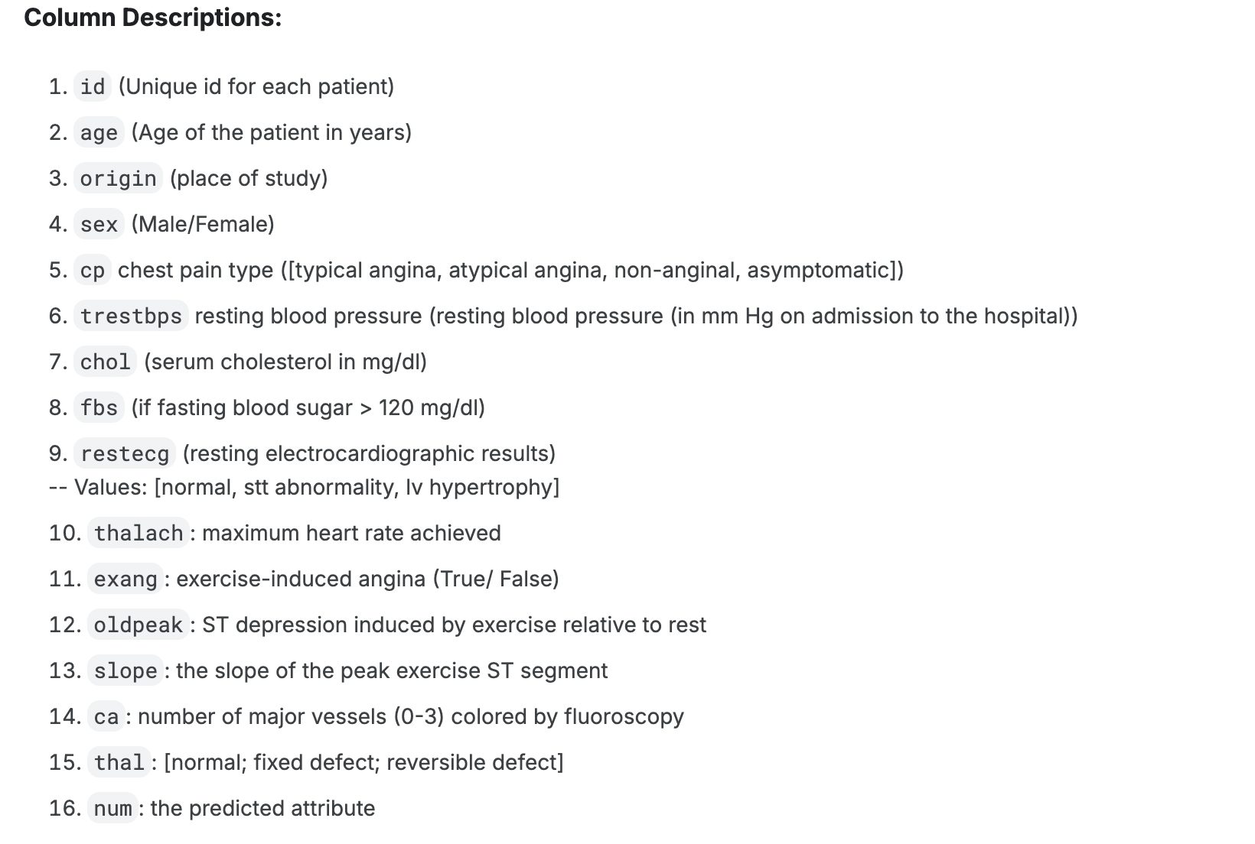
DATASET OVERVIEW
Total 920 patients
Total of 16 columns in the dataset
Features: Clinical and diagnostic indicators such as:
Age, sex, resting blood pressure, cholesterol, Chest pain type, exercise-induced angina, ECG results, etc.
Final num column
Gives severity of heart disease (0–4 severity scale)

Slide 5
PROJECT GOALS
Build SparkML models to predict:
Heart disease diagnosis (binary classification)
Heart disease severity (multiclass classification)
Evaluate performance using:
AUC for binary classification
Accuracy for multiclass classification
Identify the most important features for prediction

Slide 6
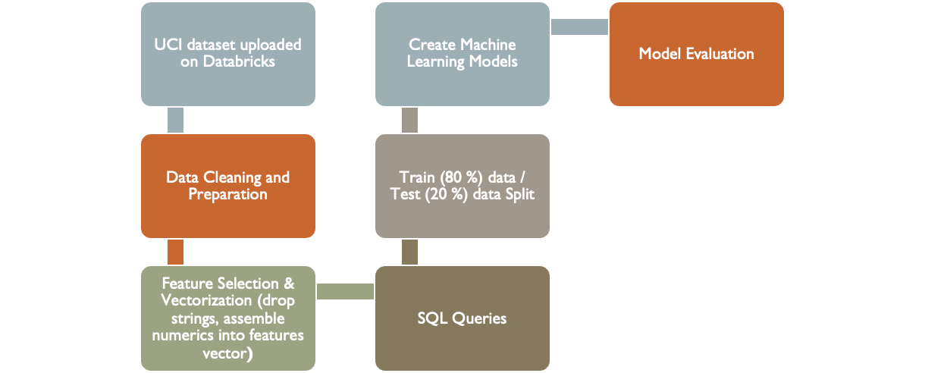
DATA FLOW

Slide 7
COMPONENTS USED FOR ANALYSIS
Component | Description
StringIndexer | Encoded categorical variables like cp, thal, sex, etc.
StandardScaler | To normalize numerical values
PySpark | Python API for Spark used to process, clean, and model the data
VectorAssembler | Combines multiple feature columns into a single feature vector column
Train/Test Split | Randomly splits dataset into 80% training and 20% testing subsets
SparkML Pipeline | Chains steps like vectorization and modeling into one reproducible process
Logistic Regression | Linear binary classifier used for disease prediction
Random Forest | Ensemble-based model used for both binary and multiclass tasks
Decision Tree | Simple interpretable classifier used for multiclass prediction
GBTClassifier | Attempted but not used — only supports binary labels in Spark
BinaryClassificationEvaluator | Used to calculate AUC for binary classifiers
MulticlassClassificationEvaluator | Used to calculate accuracy for multiclass models
MLflow (Databricks) | Automatically tracks model runs, metrics, and artifacts

Slide 8
DATA CLEANING
•The heart disease dataset is loaded into a PySpark Dataframe named HD_df.
•Imports the essential PySpark libraries required for the heart disease prediction project.
•Dropped the columns that are not required for the prediction.
•Replaces 0 values in the resting blood pressure(trestbps) and in cholesterol(chol) columns with NaN as 0 is not a physiologically valid value.
•Checked for missing values across all columns to identify data quality issues.
•Dropped columns with more than 50% missing data, as they lacked reliability.
•Imputed missing values:
Replaced missing numeric values with the median.
Replaced missing categorical values with the mode.
•Encoded categorical variables using StringIndexer to make them usable in ML models.
•Normalized numerical features using StandardScaler for better model performance.

Slide 9
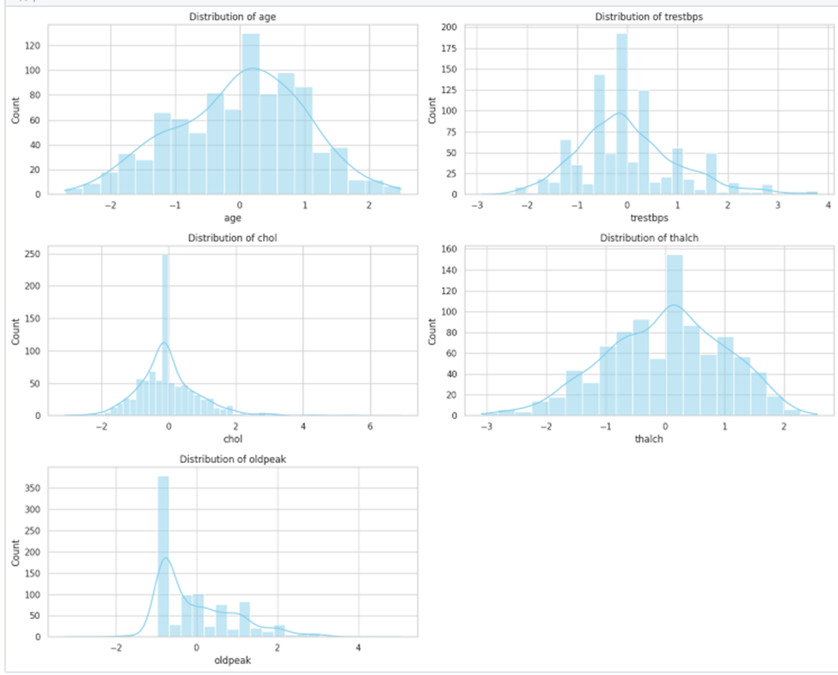
Data Visualization
•Converts the PySpark DataFrame to pandas so we can use popular Python plotting libraries like Seaborn and Matplotlib.
•Plots histograms for five important numerical features:
age, trestbps (resting BP), chol (cholesterol), thalch (max heart rate), and oldpeak.
•Helps understand each feature's shape, spread, and distribution.
•Useful for:
•Checking if features are normally distributed.
•Detecting potential outliers or skewness.
•Ensuring normalization was successful.
Conclusion:
The plots show that most features are well normalized, with age, trestbps, chol and thalch appearing normally distributed. However, oldpeak is right-skewed, may need transformation.

Slide 10
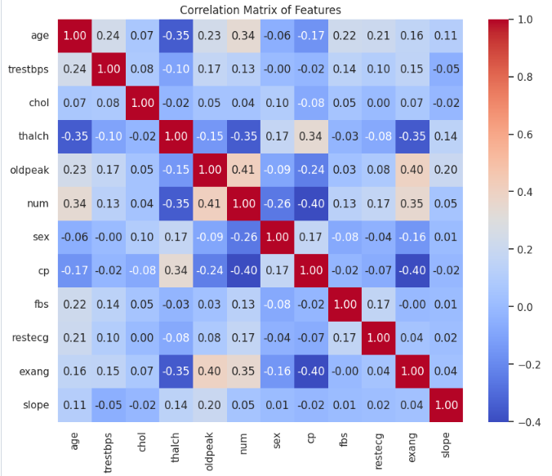
Correlation Analysis of Features
Key Insights from the Correlation Matrix
Strongest Positive Correlations:
•cp (chest pain type) and num (target): +0.41
Certain chest pain types are strongly associated with heart disease.
•oldpeak and num: +0.41
Greater ST depression (oldpeak) is linked with a higher risk of heart disease.
•exang (exercise-induced angina) and num: +0.35
Presence of angina during exercise correlates with heart disease.
Strongest Negative Correlations:
•thalch (max heart rate) and num: −0.35
Lower maximum heart rate is associated with a higher chance of heart disease.
•cp and exang: −0.40
Patients with chest pain are less likely to have exercise-induced angina.
Other Observations:
•age and thalch: −0.35
Older patients tend to have a lower maximum heart rate.
•num correlates with multiple features, but no extremely high values — meaning prediction relies on multiple weak-to-moderate predictors.
Conclusion:
No features are highly collinear, which is good for modeling.
Features like cp, oldpeak, thalch, and exang are important indicators of heart disease and should be prioritized in feature selection.

Slide 11
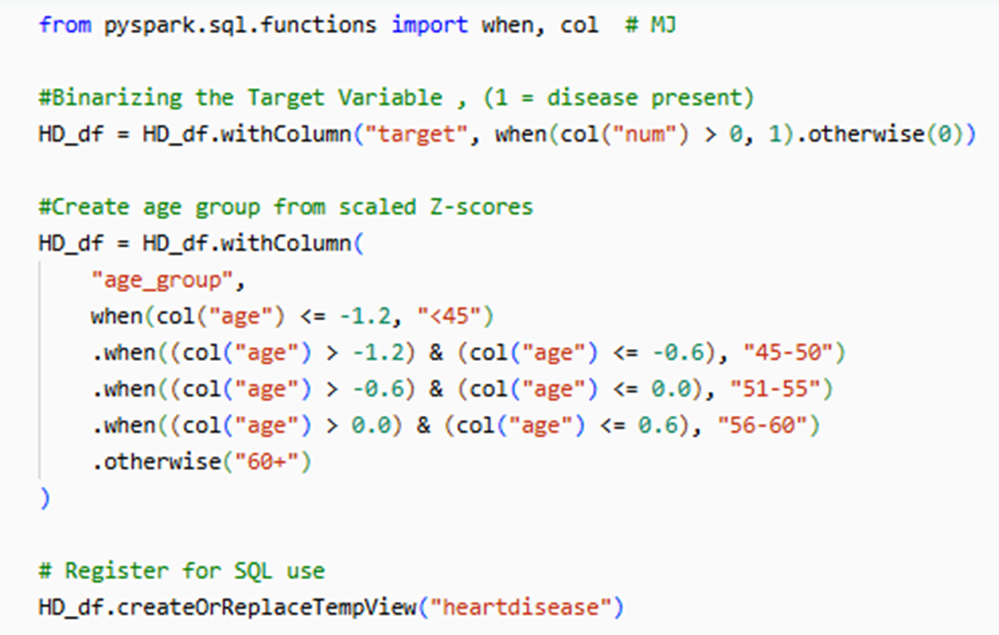
Feature Engineering
•Created a binary target variable from num to enable classification modeling
(1 = disease present, 0 = not present).
• Age-group categories from scaled age values for grouped analysis and improved model interpretability.

Slide 12
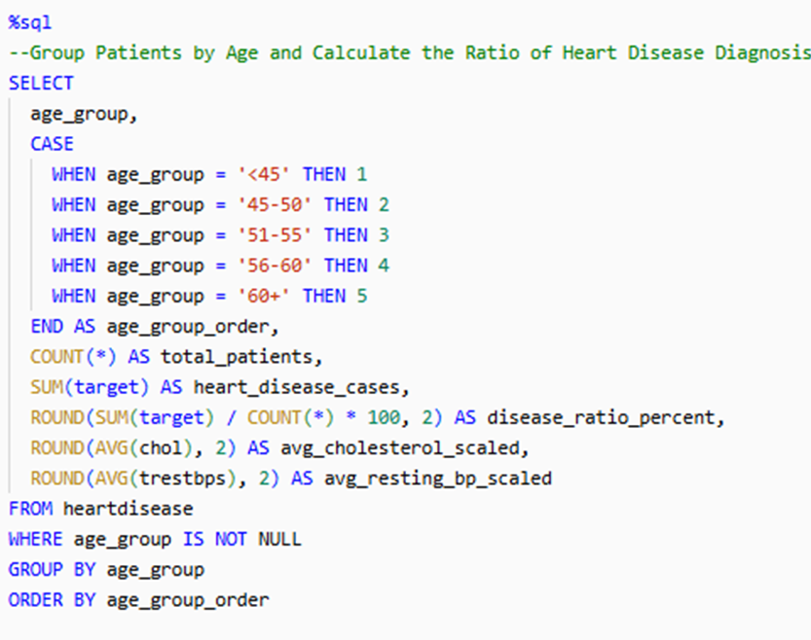
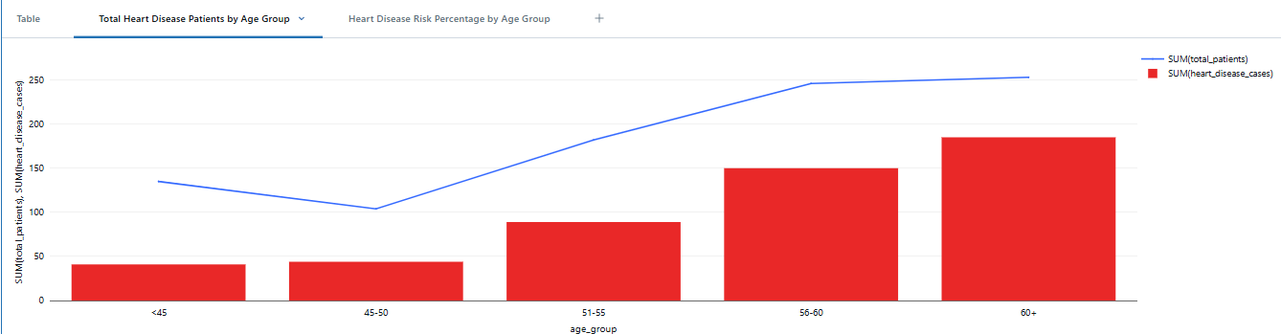
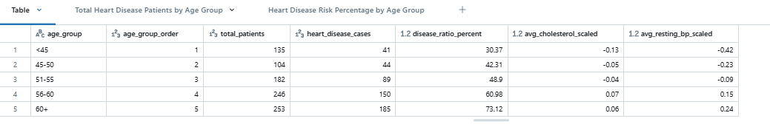
SQL QUERIES
Heart Disease Summary by Age Group

Slide 13
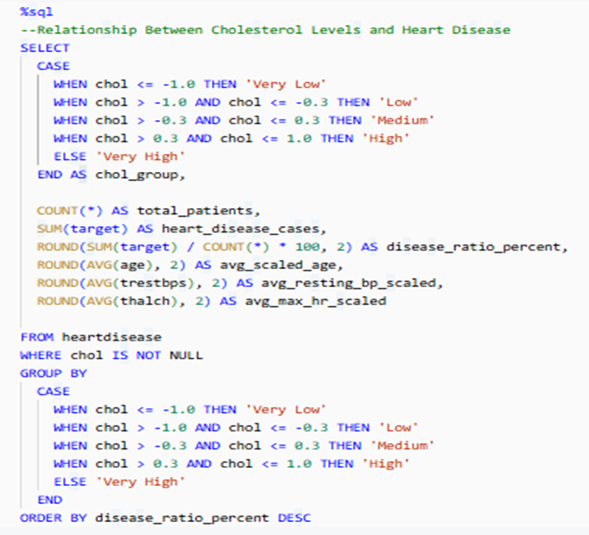
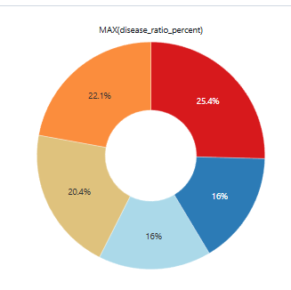
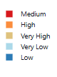
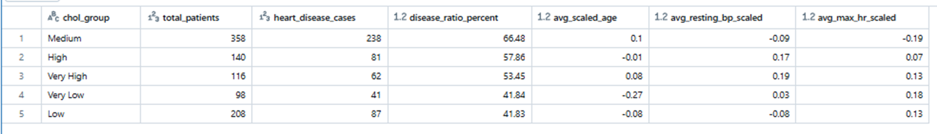
2. Relationship Between Cholesterol Levels and Heart Disease

Slide 14
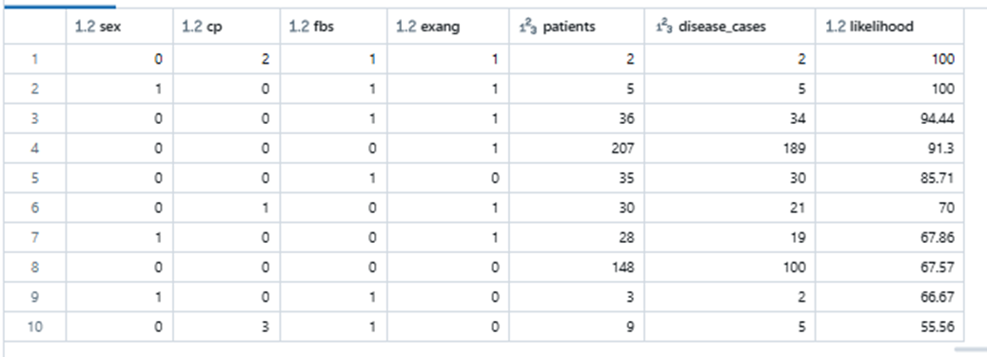
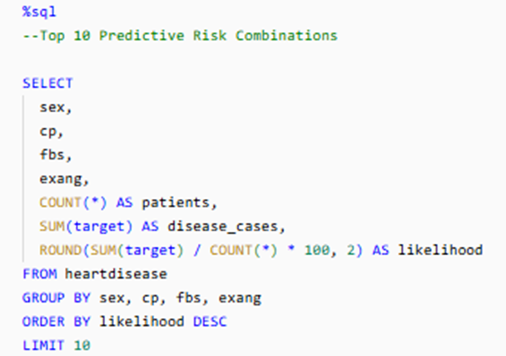
3.Top 10 highest-risk patient profiles
•This SQL query groups patients by randomly selected feature combinations, Some combinations show very high disease likelihood even up to 100% (rows 1 & 2).
•These combinations can be used as risk flags or clinical rules, identifying patients most likely to have heart disease.
•To improve accuracy, ML models can be used to identify the most predictive features

Slide 15
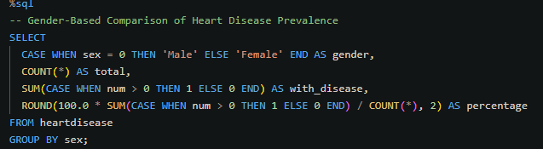
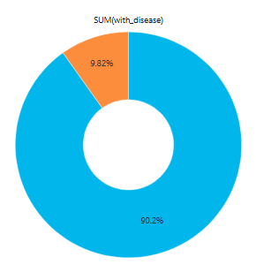
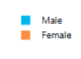
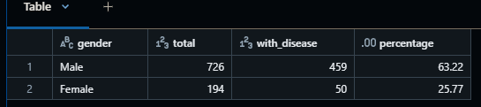
4 . Gender-Based Comparison of Heart Disease Prevalence

Slide 16
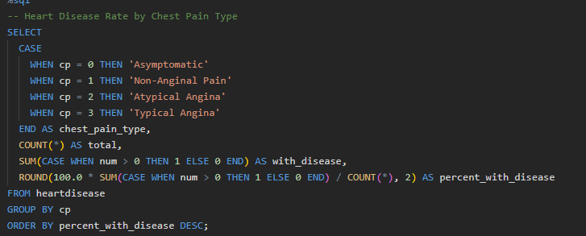
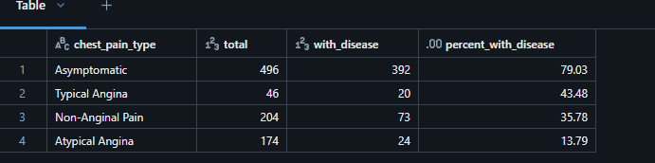
5. Heart Disease Rate by Chest Pain Type

Slide 17
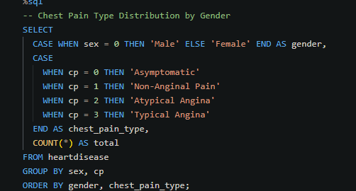
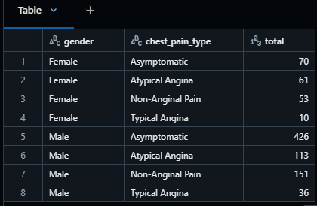
6. Chest Pain Type Distribution by Gender

Slide 18
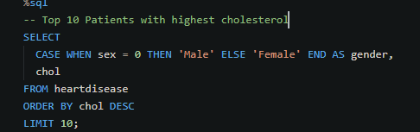
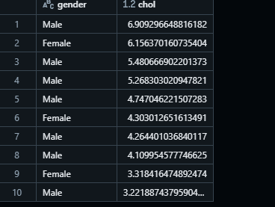
7. Top 10 Patients with Highest Cholesterol

Slide 19
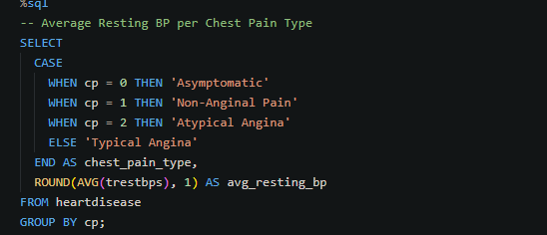
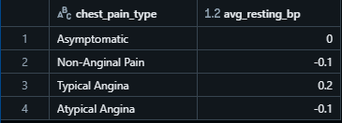
8. Average Resting BP per Chest Pain Type

Slide 20
MACHINE LEARNING MODELS
Implemented 4 machine learning models using Spark ML pipelines to predict heart disease risk and severity:
Two models to predict whether a patient has heart disease (target: 0 = no heart disease, 1 = heart disease)
Logistic Regression model
Random Forest model
Multilayer Perceptron (MLP)
Adaboost Classifier
Two models to predict the severity of heart disease (num: 0 to 4 severity)
Decision Tree
Random Forest (multiclass)

Slide 21
ML: FEATURE ENGINEERING
 | Transformation | Why
Age Binning (age_bucket) | Bucketed age into 3 groups: young (≤40), middle-aged (41–55), older (56+) | -Captures non-linear risk patterns -Improves splits for tree models -Easier to interpret age-related trends
Interaction Term (age * chol) | Created new feature age_chol_interaction | -Models combined effect of age and cholesterol -Highlights high-risk subgroups (e.g., older adults with high cholesterol) -Useful for models that don’t learn interactions naturally
Feature Scaling | Applied StandardScaler to all features | -Ensures fair treatment of all features -Critical for gradient-based models (e.g., MLP, Logistic Regression) -Improves convergence speed and stability

Slide 22
MODELS
(Target: 0 = No Disease, 1 = Has Disease)
Model | Purpose | Why We Used It
Logistic Regression | Predicts the probability of heart disease (binary classification). | Baseline model that is interpretable, fast, and performs well on linearly separable data.
Random Forest (Binary) | Uses multiple decision trees to classify patients. | Captures complex interactions and reduces overfitting through ensemble learning.
Multilayer Perceptron | Neural network with hidden layers. | Handles nonlinear patterns and learns from deeper feature relationships.
AdaBoost Classifier | Boosts the performance of weak learners sequentially. | Often outperforms simpler models by focusing on hard-to-classify cases.

Slide 23
MODELS
(Target: num = 0 to 4)
Model | Purpose | Why We Used It
Decision Tree (Multiclass) | Splits patient data to assign a severity class. | Easy to interpret and visualize; helps understand key features per class.
Random Forest (Multiclass) | Uses an ensemble of trees to predict severity class. | More accurate than a single tree and robust for multiclass tasks.

Slide 24
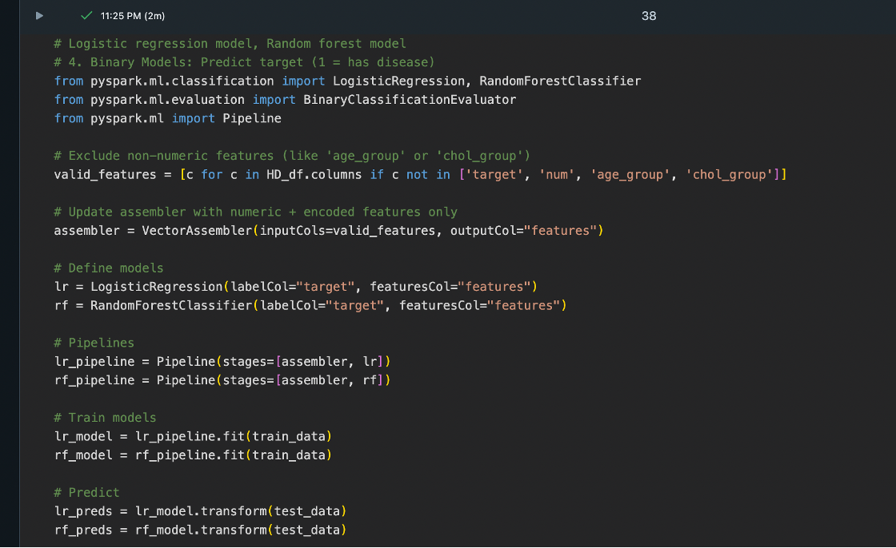
LOGISTIC REGRESSION / RANDOM FOREST MODEL (BINARY CLASS)

Slide 25
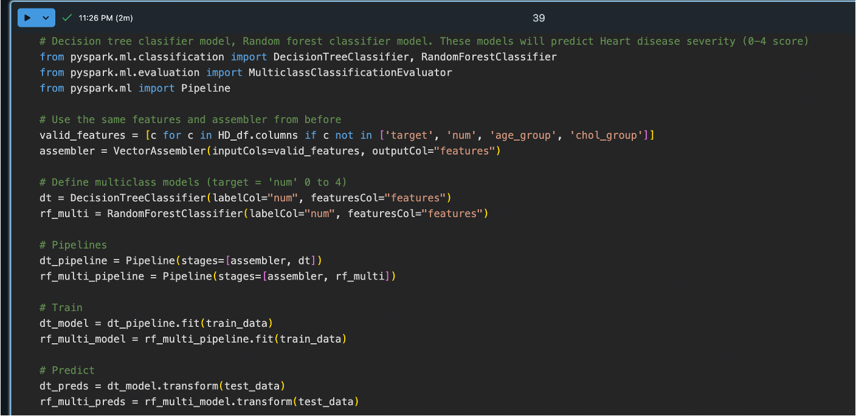
DECISION TREE CLASSIFIER / RANDOM FOREST (MULTICLASS)

Slide 26
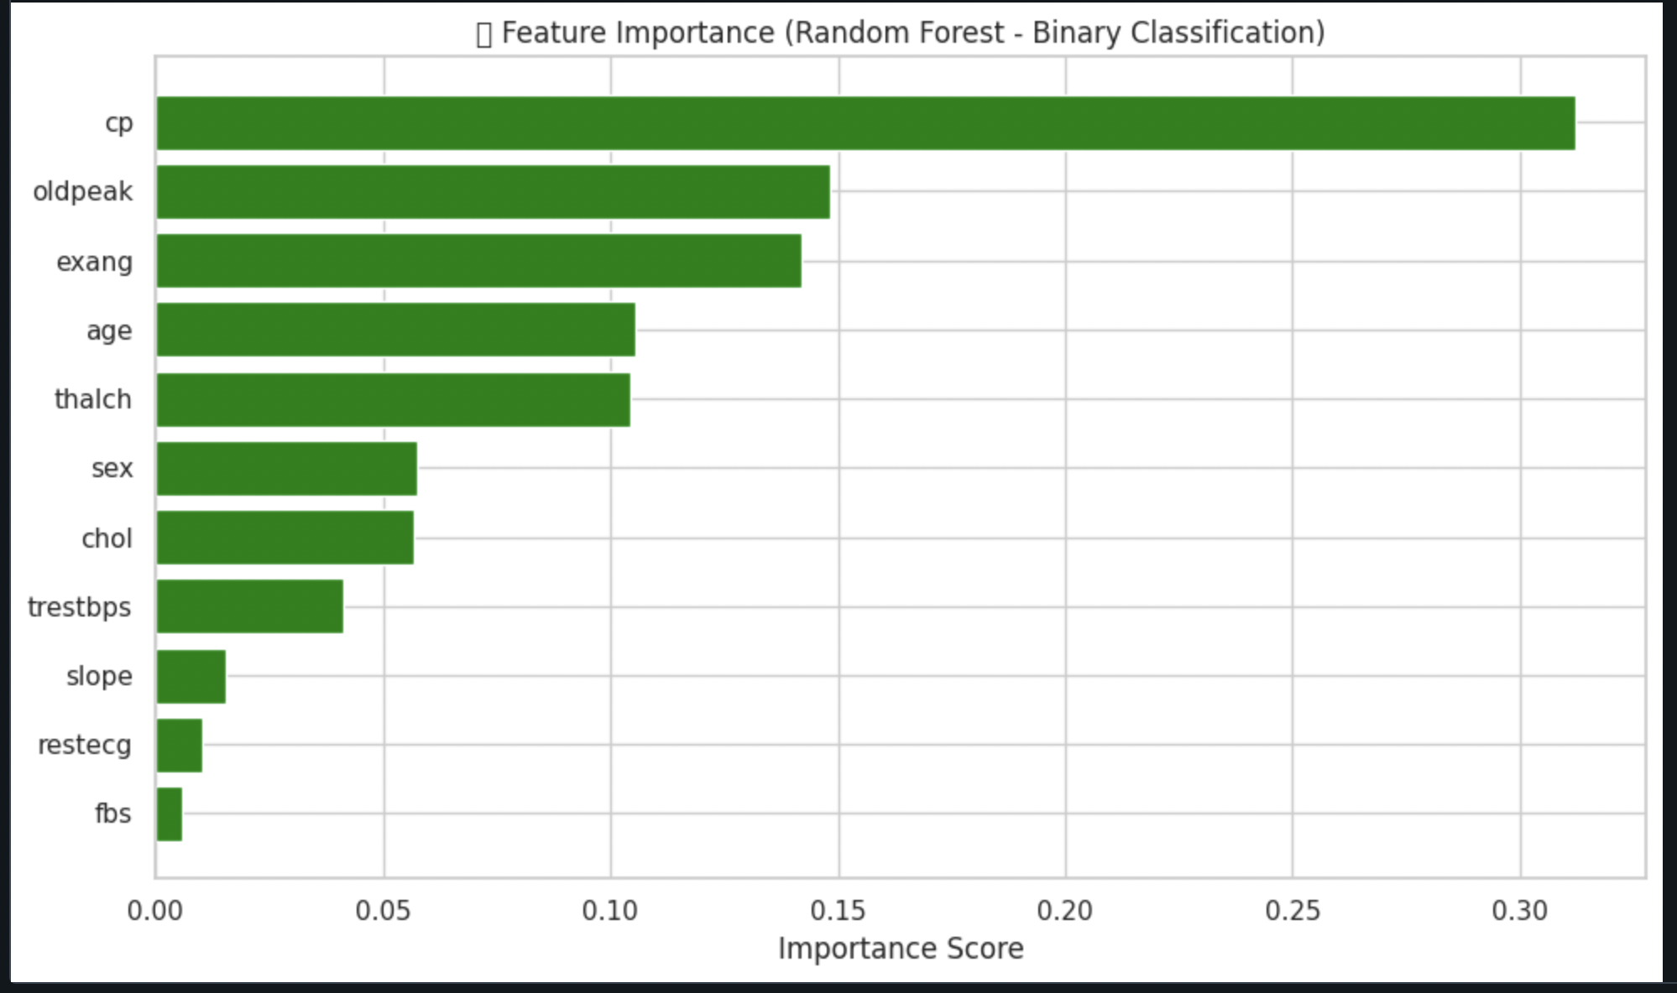
FEATURE IMPORTANCE
Random Forest model ranked chest pain type (cp), ST depression (oldpeak), and exercise-induced angina (exang) as the most predictive features of heart disease.

Slide 27
MODEL RESULTS
Model | Type | Target | Metric | Score
Logistic Regression | Binary Classifier | target | AUC | 0.8435
Random Forest (Binary) | Binary Classifier | target | AUC | 0.8317
Multilayer Perceptron AUC | Binary Classifier | target | AUC | 0.8012
Gradient Boosted Trees | Binary Classifier | target | AUC | 0.8567
Decision Tree (Multiclass) | Multiclass Classifier | num | Accuracy | 0.4295
Random Forest (Multiclass) | Multiclass Classifier | num | Accuracy | 0.4966

Slide 28
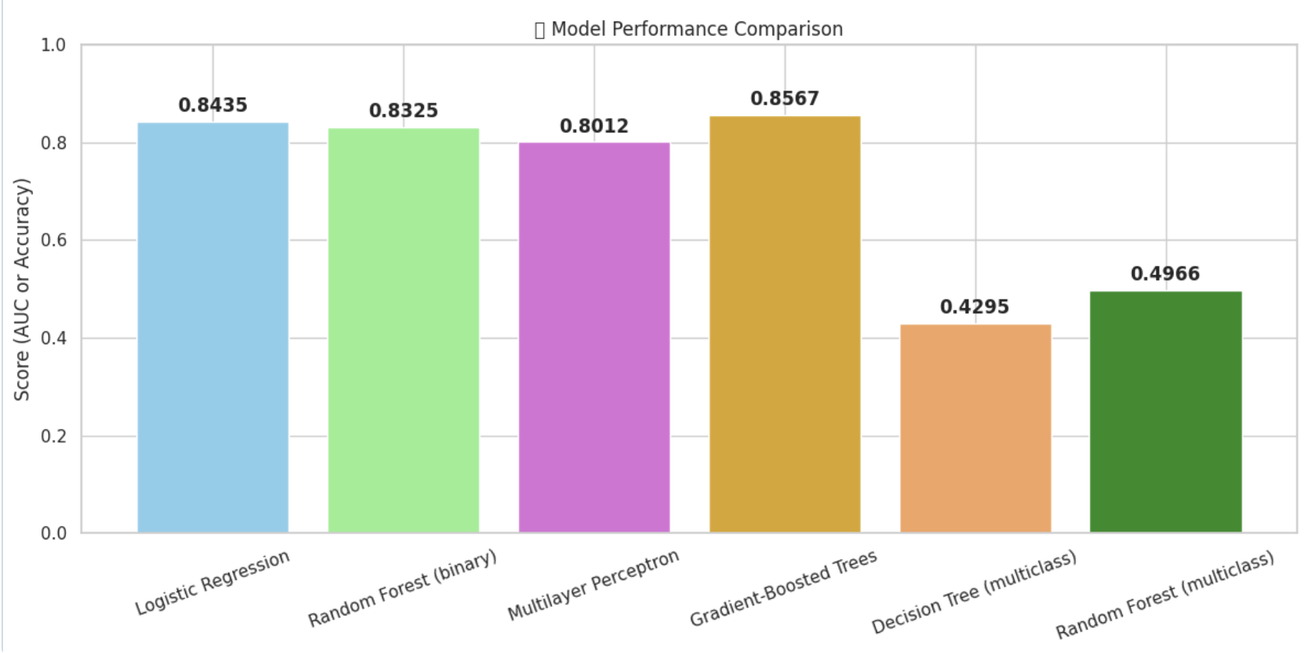
MODEL ACCURACY
AUC comparison and Accuracy comparison

Slide 29
CONCLUSION
Summary of what we did:
Uploaded heart disease dataset to Databricks, Cleaned and Prepared data, Performed Analysis using SQL queries, Built and Evaluated ML models
Best model Recommendation
Binary: Gradient - Boosted Trees
Multiclass models - Random Forest
Multiclass models less reliable that binary classifier models.
Analysis helpful for Physicians:
Helps physicians identify patients at risk of heart disease using ML based predictions.
Severity prediction (0-4 scale) may help with treatment planning, but caution is needed due to moderate accuracy of models.
Future recommendations:
Collect more data or additional clinical features to improve model accuracy.
Explore deep learning architectures or advanced ensemble strategies for better model performance.
Conclusion: Machine learning can assist in heart disease screening, but further improvements are needed for predicting severity.

Slide 30
CHALLENGES
Challenges | Solution
Incomplete dataset - Some columns had missing data. | Dropped columns with too much misisng data, applied mean/mode imputation
Dataset contained string and boolean features not usable by ML models | Applied StringIndexer to encode categorical variables
Numerical features had different scales | Used StandardScaler for normalization
Target variable was not binary | Created a binary target column using when(col("num") > 0, 1).otherwise(0)
Model Error with GBTClassifier - didn’t work for multiclass severity prediction | Switched to Random Forest, which supports multiclass in Spark

Slide 31
Thank You

